Slide 1
Demand Estimation of Full-Cut Promotion on E-Commerce Company
Wong JING HUI
Supervisor: Asst Prof Yan Zhen Zhen
Notes:
Good afternoon professors, my name is Jing Hui
today I am presenting on the FYP topic: Demand estimation of full-cut promotion on an E-commerce company, which is VIPshop.
My deepest thanks to Prof Yan, my supervisor of this FYP. I am fortunate to be introduced into the field of operation research and learn more about revenue management.

Slide 2

CONTENTS
OBJECTIVE
METHODOLOGY
CONCLUSION
Notes:
Objective, Exploratory Data Analysis, Methodology, Customer type estimation, Conclusion
The contents for this presentation:
begins with the objective, what are the motivations for this FYP, what are the objectives that we want to achieve
This is followed by introducing our proposed methodology, comparative study to existing techniques.
And then a conclusion, on the significance of our proposed methodology and future work.

Slide 3


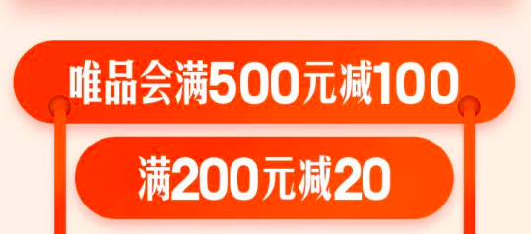
WHAT IS FULL-CUT PROMOTION?
Pay minimum threshold amount to enjoy fixed discount to entire order.
discount amount
Threshold amount
Figure 2. Extracted from Taobao.com
Figure 1. Extracted from VIPshop.com
Figure 3. Extracted from Tmall.com
Notes:
What is a Full-cut promotion?
Full-cut promotion is a type of promotion where customers spend a minimum threshold amount in a single order to enjoy a fixed discount amount
This is shown in the coupons from VIPshop, with a minimum spend of ¥500 to discount ¥100 to the entire order.

Slide 4
OBJECTIVE
Motivations for researching on full-cut promotions in E-commerce.
Growing popularity
No existing literature
Full-cut promotions are popular and widely used in E-commerce such as TaoBao and VIPshop.
No existing literature on the demand estimation and optimisation of full-cut promotions in E-commerce.
Costly promotions
Demand Estimation + Optimisation
Promotions are very costly for an E-commerce company. We seek to implement revenue management of full-cut promotions.
Our objective is to introduce an approach that estimates customers’ demand towards full-cut promotion, optimize revenue from the promotion.
Notes:
The motivations for this research is to answer questions on how can we optimize our full-cut promotions for revenue management in E-commerce.
This is area of research is important because of the growing popularity in Full-cut promotion. It is a widely used promotion used in China E-commerce companies such as Taobao and VIPshop.
In 2017, retail e-commerce sales worldwide amounted to US$2.3 trillion and e-retail revenues are projected to grow to US$ 4.88 trillion in 2021. In 2017, China accounts for 40% of global retail e-commerce. For E-commerce companies to succeed, especially in China, It is important for them to optimize their revenue from full-cut promotions.
Yet, there is no academic literature on the demand estimation and optimisation of full-cut promotion. One of the biggest issue lies in the discontinuity of the prices for the orders which makes it difficult to optimise.
Another important motivation for this research is that promotions are extremely costly to an E-commerce company. Incurring a huge part of their marketing budget. Being able to estimate the full-cut demand allows us to measure the performance of the promotions and therefore know how to optimize these promotions.
Our objective is to estimates customers’ demand towards full-cut promotion to measure the performance of the promotion
To optimize the revenue from full-cut promotions.

Slide 5
OBJECTIVE
Challenges in Demand Estimation of full-cut promotions.
Full-cut promotion sensitivity
Customer Data Sparsity
In an aggregated transactional dataset, no information on which customers are subscribed to full-cut promotion. How do we identify the types of full-cut promotion? How do we measure their sensitivity to full-cut promotion?
Customer segmentation often involve using customer demographics. However, due to privacy issues, the data is not readily available. Also, highly sparse. How can we segment customers well using a product-level transactional dataset?
Notes:
There are 2 parts to the research on full-cut promotions:
Demand estimation
Optimisation
The challenges for demand estimation are 2 folds:
1) Extracting full-cut promotion sensitivity.
From aggregated transactional dataset, how can we identify the types of full-cut promotions,
and how can we measure the sensitivity of customers towards the full-cut promotion?
2) Customer data sparsity
Customer segmentation often involves customer demographics. But this data is usually not available to empirical researchers due to privacy issues.
Also, the data is likely to be sparse with missing information and invalid gender, age, salary. How can we use the product-level features in transactional dataset to segment customers well?

Slide 6
METHODOLOGY
Outline of methodology.
Exploratory Data Analysis
Propose model for promotion sensitivity
Identify the types of Full-cut promotions. Understand the distribution of discount and threshold amounts.
Define promotion sensitivity, differentiate customers’ attraction towards full-cut promotion using on price-to-threshold distance, no. of products purchased.
Customer Segmentation
Machine Learning + Optimisation
Segment customers based on promotion-driven demand. Comparative study of choice probabilities with Conditional Gradient approach.
Apply machine learning to investigate relationship between features and promotion demand. Set up framework to optimize threshold and discount amount for revenue management.
Notes:
We have a 4-step methodology with the outline as follows:
We begin by exploring the data to identify the types of full-cut promotion in a noisy transactional dataset.
We then propose a model to measure customer’s sensitivity towards full-cut promotion. Equivalently this is called promotion-driven demand.
Thereafter, we carry out customer segmentation based on this predicted promotion-driven demand. We also implemented a benchmark model, conditional gradient approach, for comparative study.
The final section is to use Machine learning to investigate relationship between the features and promotion-driven demand and
set up framework for optimization of the full-cut promotions based on the information obtained in the previous sections, such as the customer types, and predicted output.

Slide 7
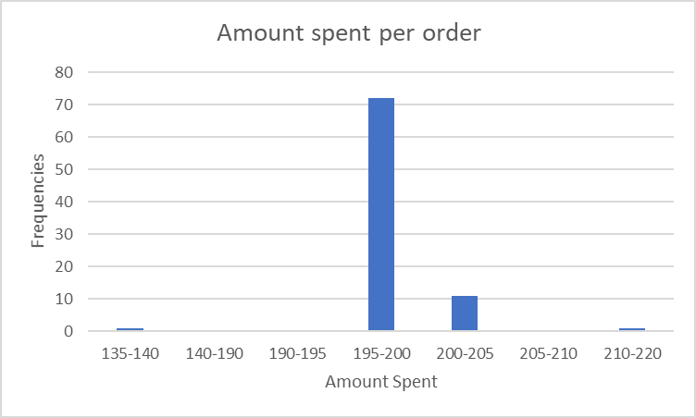
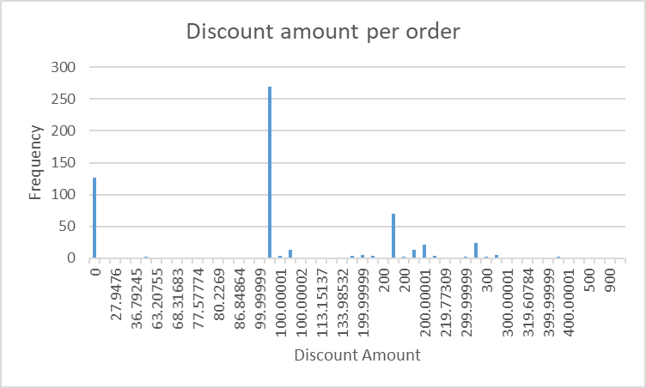
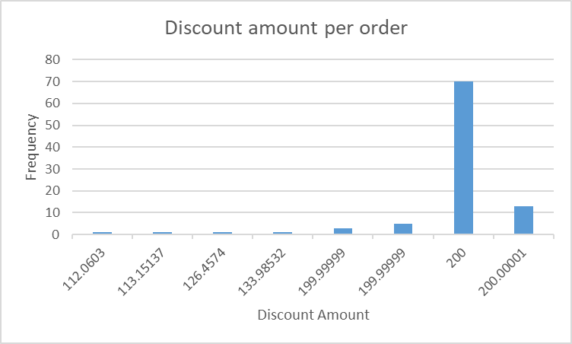
EXPLORATORY DATA ANALYSIS
Identify discount amount.
Figure 5. Histogram plot for discount amount in each order (¥100-¥200 interval)
Full-Cut Discount Amount | Threshold Amount
¥100 | ¥199
¥200 | ¥398
¥300 | ¥597
Figure 4. Histogram plot for full-cut discount amount in each order
Table 1. Proposed Full-cut discount amount and threshold amount
Notes:
In exploratory data analysis, we construct a methodology to identify the discount and threshold amount of full-cut promotions and understand the distribution of discount amount, threshold amount based on the frequencies of orders.
The first step is to identify the discount amount in the full-cut promotions. This is done by plotting the histogram of the frequencies of each discount amount in the orders, as shown in figure 1. We can observe that ¥100, ¥200 have a spike in frequencies.
Next, we plot the histograms based on intervals of ¥0 - ¥100, ¥100 - ¥200, ¥200 - ¥330 as shown in figure 2 to observe the trends and frequencies clearly. We can observe a trend of a spike in frequency followed by a decreasing trend of frequencies. We propose that discount amounts with a spike in frequency are the discount amounts in the full-cut promotion. The variation of discount amounts is caused by the different types of promotions in the dataset. Since over 95% of the total discount amount is from full-cut promotions, the discount amount resulting solely from full-cut promotions will have a spike in frequency compared to its neighborhood of discount amounts.
Hence, we propose that ¥100, ¥200, ¥300 are discount amounts in the full-cut promotion.

Slide 8
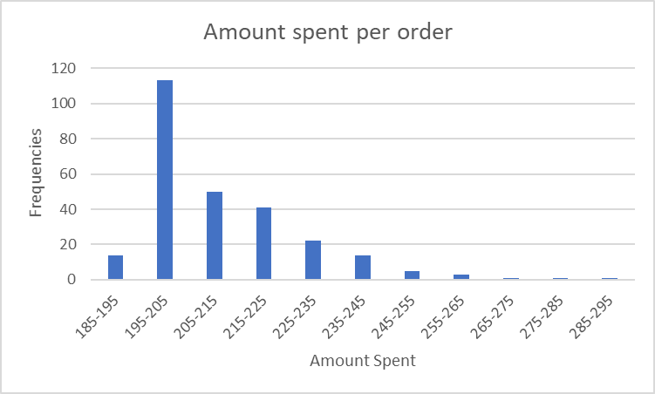
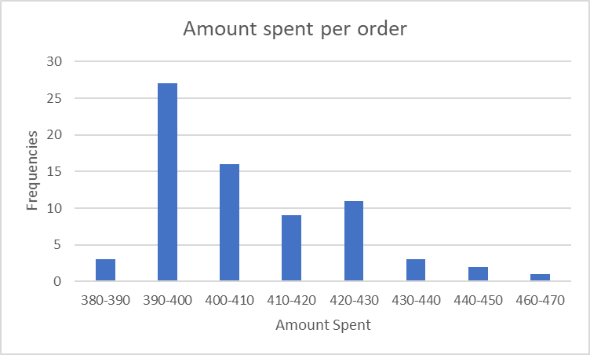
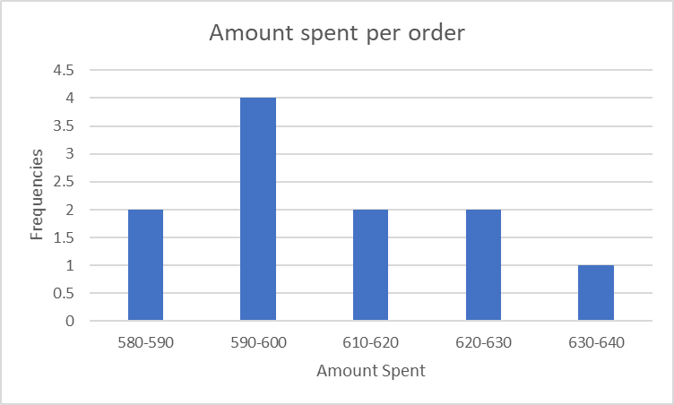
EXPLORATORY DATA ANALYSIS
Identify corresponding threshold amount.
Figure 7. Histogram plot for amount spent per order (for ¥200 discount amount)
Figure 6 Histogram plot for amount spent per order (for ¥100 discount amount)
Full-Cut Discount Amount | Threshold Amount
¥100 | ¥199
¥200 | ¥398
¥300 | ¥597
Table 1. Proposed Full-cut discount amount and threshold amount
Figure 8. Histogram plot for amount spent per order (for ¥300 discount amount)
Notes:
The next step is to identify the corresponding threshold amounts. For the orders with the discount amounts of ¥100, we create a histogram plot to find their corresponding frequencies in amount spent for the entire order, as shown in figure 3.
We can also observe a trend of a spike in frequency followed by a decreasing trend of frequencies. We propose that the order amount with a spike in frequency is the threshold amount in the full-cut promotion. This is intuitive as customers would want to spend an amount that is near or at the threshold amount to maximize their monetary benefit from this full-cut promotion. Specifically, between ¥195-¥205, frequencies of orders with ¥199 occurs the most frequently, hence it is proposed as the threshold amount.
By the same logic and method, for orders with discount amounts of ¥200 and ¥300, the corresponding threshold amounts are ¥398, ¥597
Additionally, the number of frequencies for each order amount also provides an insight on the customers’ preference to which types of full-cut promotions. Here, we can observe that more customers subscribe to the ¥100 full-cut promotion than ¥300 full-cut promotion.

Slide 9
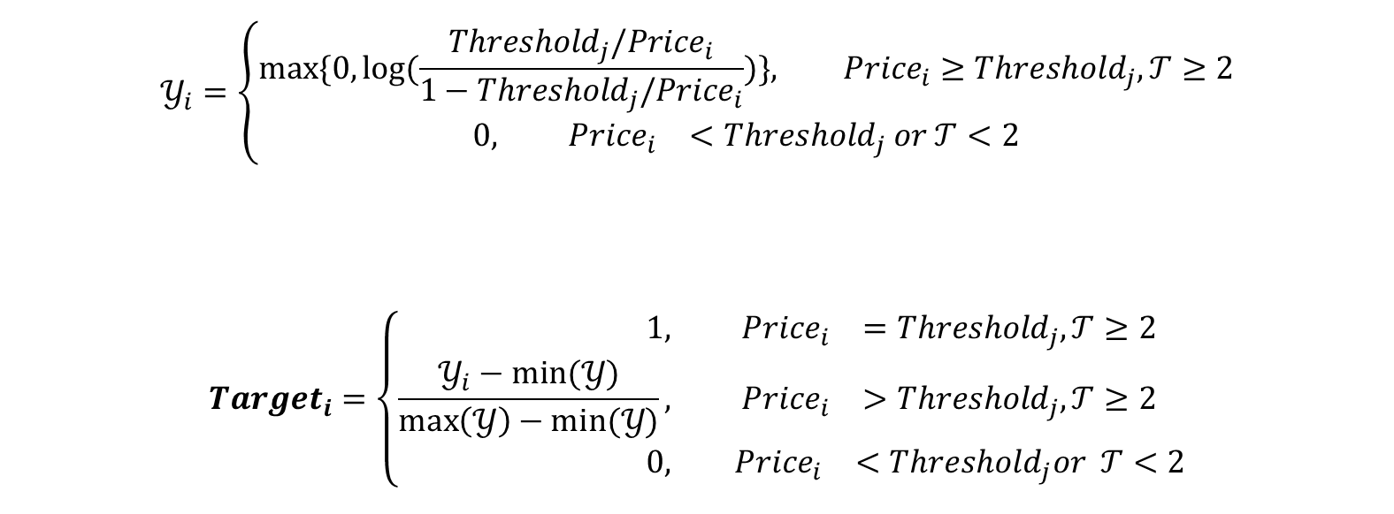
PROPOSED MODEL FOR PROMOTION SENSITIVITY
Formulation of promotion-driven demand on threshold and order amount.
$$𝒴_{i}=\left\{\begin{aligned}max\{0, log{(\frac{{Threshold}_{j}/{Price}_{i}}{1−{Threshold}_{j}/{Price}_{i}})}\}, {Price}_{i}≥{Threshold}_{j}, 𝒯≥2 \\ 0, &{ Price}_{i}<{Threshold}_{j} or 𝒯<2\end{aligned}\right.$$
$${Target}_{i}=\left\{\begin{aligned}1, &{ Price}_{i}={Threshold}_{j}, 𝒯≥2 \\ \frac{𝒴_{i}−min⁡(𝒴)}{\max\left(𝒴\right)−min⁡(𝒴)}, &{ Price}_{i}>{Threshold}_{j}, 𝒯≥2 \\ 0, &{ Price}_{i}<{Threshold}_{j}or 𝒯<2\end{aligned}\right.$$
Logit transformation is represented as $\log\left(\frac{p\left(X\right)}{1−p\left(X\right)}\right)$.
${Threshold}_{j}/{Price}_{i}$ represents $p\left(X\right),$the probability of a customer being attracted to the full-cut promotion for ${Price}_{i}≥{Threshold}_{j}$
Notes:
The output (Target) is a continuous value between 0 to 1 and reflects the full-cut promotion driven demand in each order.
This value is obtained by finding the maximum value between 0 and the output of a modified logit transformation on the price of each order (before full-cut promotion) and then normalizing the resulting value into a range between 0 to 1.
$𝒯$ denotes the number of goods purchased in each order.
$𝒾=1,2,3…𝒩$ denotes the order ID
${Threshold}_{j}=¥199, ¥398, ¥597 for j=1, 2, 3$ denotes the threshold amount
This makes senses because logit transformation is often used to model consumer choice probabilities, in this case the choice of subscribing or not subscribing to the promotion.
${Threshold}_{j}/{Price}_{i}$ represents $p\left(X\right),$which is the probability of a customer being attracted to the full-cut promotion in the case of ${Price}_{i}≥{Threshold}_{j}$. This is intuitive as a customer who spends an amount near to the threshold amount is likely to indicate that the customer is attracted to this full-cut promotion. Hence the closer the amount, ${Price}_{i},$to the threshold amount, ${Threshold}_{j}$, the higher the probability of the customer being attracted to the full-cut promotion, given that ${Price}_{i}≥{Threshold}_{j}$.
${Price}_{i}≫{Threshold}_{j}, \log{(\frac{{Threshold}_{j}/{Price}_{i}}{1−{Threshold}_{j}/{Price}_{i}})}<0$, we take the value of 0 by applying the maximum function. This is intuitive since when the amount spend exceeds the threshold amount by a large margin, the customer is no longer interested in the promotion and the promotion driven demand is assigned as 0.
When ${Price}_{i}<{Threshold}_{j},$ the customer is not subscribed to the full-cut promotion and hence the promotion driven demand is assigned as 0. The above formula for normalization scales the promotion-driven demand, ${Target}_{i}$, to a range between 0 to 1, which enables a comparison to a consistent range of values of demand to different orders.
The promotion driven demand is defined as the willingness of a customer to purchase due to the promotion. Therefore, we assumed that customers who purchase only a single product in an order are not influenced by the full-cut promotion.

Slide 10
CUSTOMER SEGMENTATION
Clustering based on promotion-driven demand.
 | Optimal number of clusters | Mean Silhouette score
K-means | 3 | 0.6367
K-medoids | 3 | 0.6209
Hierarchical clustering (Ward Linkage) | 3 | 0.5842
Hierarchical clustering (Ward Linkage) | 4 | 0.6201
Hierarchical clustering (Single Linkage) | 3 | 0.6557
Hierarchical clustering (Complete Linkage) | 4 | 0.6011
Hierarchical clustering (Average Linkage) | 3 | 0.6139
Hierarchical clustering (Average Linkage) | 4 | 0.6018
Figure 9. Summary of clustering models used
Notes:
In this section, we apply various clustering models on the output, predicted promotion driven demand to identify various customer types, segment customers based on their demand.
This enables companies to use simply product-level features to create different customer types without customer-level information such as demographic information on salary, age. These types of customer-level information are important for traditional clustering techniques to form customer types and yet they are often difficult to acquire or are usually sparse with many missing details. From section 3,4,6, we have introduced a method where we can segment customers simply with information on product-level features which are readily available for companies. These clusters enable companies to understand which types of customer are more attracted to full-cut promotions and hence, allocate their resources more effectively to have targeted marketing towards these customer segments to optimize their revenue from promotions.
The clustering models used are: K-means, K-medoids and Hierarchical clustering, with Ward’s Linkage, Single Linkage, Complete Linkage, Average Linkage. The mean silhouette score is also provided.
The mean silhouette approach measures the quality of a clustering and determines how well each observation lies within its cluster. A value of mean silhouette score between 0.7 to 1.0 indicates a strong clustering structure has been observed. A value of mean silhouette score between 0.51 to 0.70 indicates a reasonable clustering structure has been observed [36]. A value of mean silhouette score of less than 0.50 indicates that the clustering structure is weak and could be artificial

Slide 11
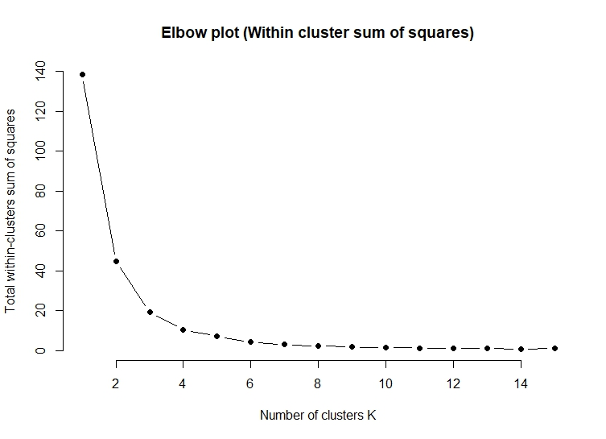
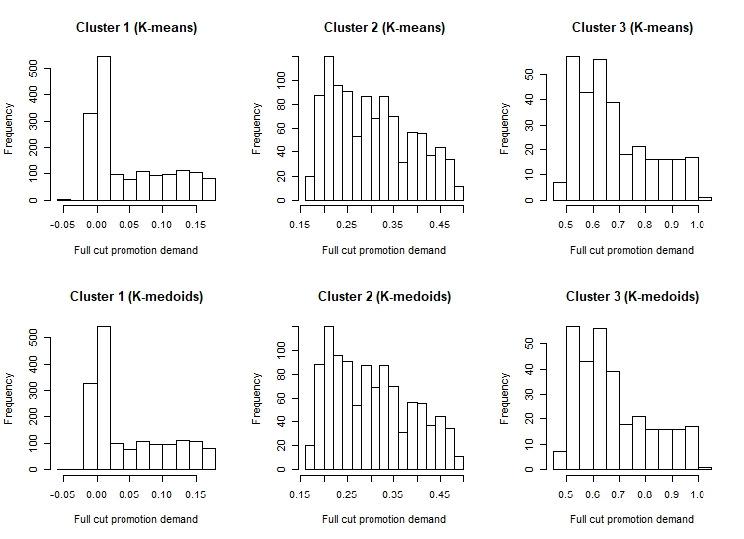
CUSTOMER SEGMENTATION
K-means selected due to silhouette score and interpretability of clusters.
Figure 10. Elbow plot to determine number of clusters (K-means)
Figure 11. Distribution of each clusters K-means K-medoids
Notes:
From the previous slide, K-means has the second highest silhouette score, and Hierarchical clustering (Single Linkage) with 3 clusters has the highest silhouette score.
However, we have selected K-means (3 clusters) as the optimal clustering model due to the interpretability of clusters. In Single Linkage, the 2nd and 3rd clusters have only 4 and 1 observations respectively.
The figure 10 shows the elbow plot to determine the number of clusters.
The optimal number of clusters is the cluster number whereby the successive cluster number has the most significant decrease in the amount of WSS reduced. The optimal number of clusters is 3 since from 3 to 4 clusters, since there is a significant decrease in WSS reduced.
With-in-Sum-of-Squares (WSS): WSS is the total distance of data points from their respective cluster centroids
WSS is a measure to explain the homogeneity within a cluster.
The histogram plots indicate that for customers from cluster 1, they are not interested in the full-cut promotion and for customers in cluster 2, customers are a slightly more interested in full-cut promotions but for some factors such as the discount amount being too low or the criteria for the full-cut promotions, the customers are not subscribing towards this promotion. Hence, feedback should be obtained from these customers to understand and tailor the full-cut promotions better for this segment. The customers from cluster 3 are highly interested in subscribing to the full-cut promotion and the threshold or discount amount can be optimized to achieve a better revenue management. This shows that customers from cluster 3 are already subscribing to the full-cut promotions while customers from cluster 2 are slightly interested but are not subscribing, whereas customers from cluster 1 are not interested at all.

Slide 12
COMPARATIVE STUDY
Conditional Gradient as benchmark model to the proposed approach.
Conditional Gradient Model^{[1]}
Reformulate mixing distribution estimation as convex problem
Optimize only through choice probabilities
Via Conditional Gradient
Algorithm and Framework provided in Appendix
Why do we choose this approach?
Uses product-level features in aggregated data
Estimate demand via choice probabilities and identify customer types
New approach, recently submitted
What are the challenges?
Understanding the intuition of the framework
Modifying objective function
Translating algorithm into code
[1] Jagabathula, S., Subramanian, L., & Venkataraman, A. (2018). A Conditional Gradient Approach for Nonparametric Estimation of Mixing Distributions.
Notes:
In this section, we seek to implement a benchmark model in segmenting and identifying different customer types to our proposed approach.
this benchmark model is a modified conditional gradient approach from Jagabathula’s paper.
This model is unique as it segments customers using product level features instead of using the traditional approach involving customer demographics. This also represents a different approach to what we have proposed and hence, The comparative study for the two approaches. Which involves the comparison of the choice probabilities across each customer type.
To identify the different customer types and the corresponding customer choice probabilities, we need to first identify the distribution of the orders across all goods based on the features.
We used 4 features: market price, discount amounts, count of goods, goods amount.
The goal is to estimate the best fitting mixing distribution based on $Data$ from the space of all possible mixing distributions $Q$, by minimizing the loss function.
The loss function we used is the squared loss function: which measures the square of the mismatch between predicted output from mixing distributions and the proportion of sales in $Data$
To find $g_{j}(Q)$ , the customer’s choice probability, we assumed that the $f_{j}\left(w\right)$ follows the Multinomial Logit model (MNL):
Hence, the customer’s choice probability is a mixture distribution, $Q$,under MNL

Slide 13
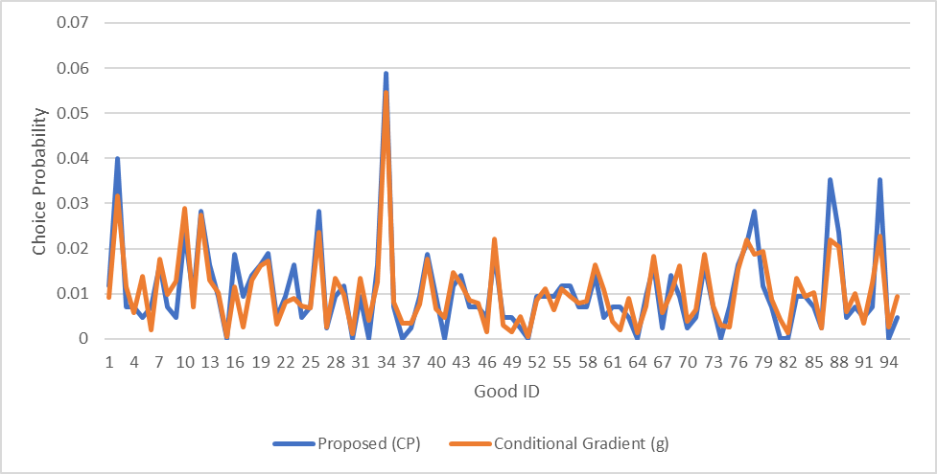

COMPARATIVE STUDY
Comparative study of customer types. Proposed vs Conditional Gradient.
$$g=α^{(1)}∗f^{\left(1\right)}+α^{\left(2\right)}∗{ f}^{\left(2\right)}+{ α}^{\left(3\right)}∗f^{\left(3\right)}$$
$${CP=w^{1}∗ CP}^{1}+ w^{2}∗{ CP}^{2}+w^{3}∗ {CP}^{3}$$
${CP}^{i}$ is a choice probability vector across for cluster $i$ in K-means
$w^{i}$ is weight of observations for cluster $i$ in K-means
Notes:
In this section, we would like to carry out a comparative study of the choice probabilities for each of the customer types ($g^{1}, { g}^{2}, g^{3}$) obtained with conditional gradient against the choice probabilities in each cluster in our proposed approach.
The comparison of choice probabilities is carried out by comparing the aggregated choice probabilities against its corresponding likelihoods, $α^{(k)}$.
For the clustering in K-means, we obtain the choice probabilities, $CP^{k}$, by computing all the sales for each of the product and is weighted based on the number of observations in that cluster.
The reason for the comparison of choice probabilities enables us to find out how similar are the predicted customer types, their purchasing behavior, in terms how likely they are going to purchase each product. Since for E-commerce companies, the full-cut promotion is optimized and applied to all customers on their websites instead of customized targeted marketing, the comparison of choice probabilities is done based on the aggregated choice probabilities across each customer type.
The plot above shows the aggregated choice probabilities of our proposed approach with the benchmark model.
The x-axis is the product ID and each point in the plot represents the customer’s predicted choice probability for that particular product ID.
Next, we compute the absolute percentage difference in choice probabilities for our proposed and benchmark model, $|CP_{j}−g_{j}|/g_{j}$
Since some products are more popular and purchased more frequently than other products across all customers, we weight the absolute percentage difference in choice probabilities with their corresponding sales, $δ_{j }= N_{j}/\sum_{j=1}^{95}{N_{j}}$.
The summation of the absolute percentage difference with the weight, $\sum_{j}{δ_{j }∗percentdiff_{j}}$, gives us an aggregated figure of 29.6%. This means that the choice probability,$CP$, on average is around 70% close to the choice probability predicted in $g$.

Slide 14
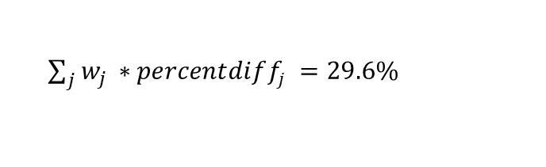
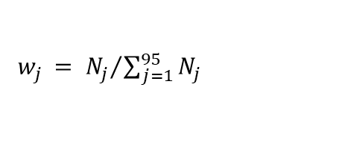

COMPARATIVE STUDY
Comparative study of customer types. Proposed vs Conditional Gradient.
$percentdiff_{j}=\left|CP_{j}−g_{j}\right|/g_{j}$
$w_{j }= {N_{j}}/{\sum_{j=1}^{95}{N_{j}}}$
70.4% similarity in choice probability
${\sum_{j}{w_{j }∗percentdiff_{j}}}_{ }=29.6\%$
Majority of error in choice probabilities occurs in good ID which are seldom purchased (lack of data)
Data-driven clustering models can yield a lower error with larger data
Notes:
In this section, we would like to carry out a comparative study of the choice probabilities for each of the customer types ($g^{1}, { g}^{2}, g^{3}$) obtained with conditional gradient against the choice probabilities in each cluster in our proposed approach.
The comparison of choice probabilities is carried out by comparing the aggregated choice probabilities against its corresponding likelihoods, $α^{(k)}$.
For the clustering in K-means, we obtain the choice probabilities, $CP^{k}$, by computing all the sales for each of the product and is weighted based on the number of observations in that cluster.
The reason for the comparison of choice probabilities enables us to find out how similar are the predicted customer types, their purchasing behavior, in terms how likely they are going to purchase each product. Since for E-commerce companies, the full-cut promotion is optimized and applied to all customers on their websites instead of customized targeted marketing, the comparison of choice probabilities is done based on the aggregated choice probabilities across each customer type.
The plot above shows the aggregated choice probabilities of our proposed approach with the benchmark model.
The x-axis is the product ID and each point in the plot represents the customer’s predicted choice probability for that particular product ID.
Next, we compute the absolute percentage difference in choice probabilities for our proposed and benchmark model, $|CP_{j}−g_{j}|/g_{j}$
Since some products are more popular and purchased more frequently than other products across all customers, we weight the absolute percentage difference in choice probabilities with their corresponding sales, $δ_{j }= N_{j}/\sum_{j=1}^{95}{N_{j}}$.
The summation of the absolute percentage difference with the weight, $\sum_{j}{δ_{j }∗percentdiff_{j}}$, gives us an aggregated figure of 29.6%. This means that the choice probability,$CP$, on average is around 70% close to the choice probability predicted in $g$.
, “good ID 2” and “good ID 34” have high weightages, representing 2.8% and 5.5% of the total transactions and they both have a very low percentage difference in choice probabilities of 2.9% and 7.8%
Conversely, “good ID 51” and “good ID 30” have a low weightage, representing only 0.044% and 0.12% of the total transactions and they both have a very high percentage difference in choice probability of 98% and 99%.

Slide 15
MACHINE LEARNING
Motivations for implementing machine learning models.
Investigate relationship between features and promotion driven demand
Insights on how features (market price, number of goods) impact promotion driven demand
Enables companies to fine-tune full-cut promotions beyond discount and threshold amount
Understand how and why customers react towards the different discount & threshold amounts
Notes:
The dataset provided by VIPshop consists of 664 orders, 620 different users and 98 categories of products
650 orders, 620 different users and 95 categories of products
The following steps were performed to clean and process the dataset:
Orders with an invalid order ID are removed.
Transactions in each order with 0 good count or discount amount are removed.
Orders with transactions that have missing information are replaced with the discount amount and amount paid based on the weighted ratio in the entire order.
The minimum price of a good in each order is calculated and added as a new feature.
The total amount paid in each order discounted with the minimum price of the good is calculated and added as a new feature.
After data processing, we have the following features:
market price, which are prices of the same product from our competitors, retailers or online retailers.
total goods count, which is the number of products purchased in that order
cut fav amount, which is the discount amount in the full-cut promotion
Min_price, which is the lowest price of the product in each order
price-min_price, which is the total amount spent in an order subtracted with the min_price
The output (Target) is a continuous value between 0 to 1 and reflects the full-cut promotion driven demand in each order.
The promotion driven demand is defined as the willingness of a customer to purchase due to the promotion. Hence, the output represents the probability that the customer will purchase additional item to subscribe to the full-cut promotion.
All the features and output are continuous variables.
Data simulation is carried out to obtain a larger dataset of 10,000 orders to achieve a higher accuracy for the training of machine learning models. A total of 10,000 orders are simulated by first carrying out a random sampling of the total good counts from the existing 650 orders. This first step of random sampling determines the order size for each new simulated order. The second step of random sampling is carried out to determine which goods id are selected from the existing 95 goods. This method of simulation ensures that new orders are generated based on the list of existing goods and the purchasing behaviors in the original dataset.

Slide 16
MACHINE LEARNING
Data Processing, Features, Output.
Feature Categories | Features | Details | Examples
Quantitative | min_price | Price of the good_id which is the lowest amongst the other prices of good_id in an order. | ¥82
 | price-min_price | price minus the minimum price. order price of good_id that the user originally intends to purchase without full-cut promotion. | ¥255
 | cut_fav_amt | Discount amount in the order | ¥0, ¥100, ¥200, ¥300
 | market_price | Prices of product from competitors such as retail or e-commerce stores. | ¥110
 | total_goods_cnt | Total number of goods purchased in the orderorder. | 1,2,8
Output (Target) | Promotion-driven demand | Apply logit transformation to price and then normalize to a range between 0 to 1. Target reflects the full-cut promotion driven-demand in each order. | 1, 0.7478, 0.6818
Notes:
The dataset provided by VIPshop consists of 664 orders, 620 different users and 98 categories of products
650 orders, 620 different users and 95 categories of products
The following steps were performed to clean and process the dataset:
Orders with an invalid order ID are removed.
Transactions in each order with 0 good count or discount amount are removed.
Orders with transactions that have missing information are replaced with the discount amount and amount paid based on the weighted ratio in the entire order.
The minimum price of a good in each order is calculated and added as a new feature.
The total amount paid in each order discounted with the minimum price of the good is calculated and added as a new feature.
After data processing, we have the following features:
market price, which are prices of the same product from our competitors, retailers or online retailers.
total goods count, which is the number of products purchased in that order
cut fav amount, which is the discount amount in the full-cut promotion
Min_price, which is the lowest price of the product in each order
price-min_price, which is the total amount spent in an order subtracted with the min_price
The output (Target) is a continuous value between 0 to 1 and reflects the full-cut promotion driven demand in each order.
The promotion driven demand is defined as the willingness of a customer to purchase due to the promotion. Hence, the output represents the probability that the customer will purchase additional item to subscribe to the full-cut promotion.
All the features and output are continuous variables.
Data simulation is carried out to obtain a larger dataset of 10,000 orders to achieve a higher accuracy for the training of machine learning models. A total of 10,000 orders are simulated by first carrying out a random sampling of the total good counts from the existing 650 orders. This first step of random sampling determines the order size for each new simulated order. The second step of random sampling is carried out to determine which goods id are selected from the existing 95 goods. This method of simulation ensures that new orders are generated based on the list of existing goods and the purchasing behaviors in the original dataset.

Slide 17
METHODOLOGY
Regression Trees have the best model performance.
 | MSE (Test set) | MAE (Test set)
Regression Tree (CART) | 0.638% | 4.223%
Regression Tree (Bagging) | 0.582% | 4.014%
Regression Tree (Boosted, GBM) | 0.143% | 1.178%
Regression Tree (XGBoost) | 0.1491 % | 1.392%
Regression Tree (H2O) | 0.140% | 1.226%
Regression Tree (Light GBM) | 0.778% | 5.051%
Artificial Neural Networks | 0.847% | 4.844%
K-Nearest Neighbors | 1.283% | 6.910%
Notes:
In this section, we train various machine learning models to estimate the output, which is the promotion driven demand and using the features shown in the previous slides.
The machine learning models used are: Decision Regression Trees (Basic Regression Trees with CART, Bagged Trees, Boosted Trees with GBM, XGBoost, H2O, LightGBM), K-Nearest Neighbors and Feedforward Neural Network.
The model performance is assessed by comparing the Mean Square Errors (MSE) and Mean Absolute Error (MAE) of both the test set and the pseudo test set via 10-fold cross validation.
All the models are trained by setting the seed as 123.
A larger emphasis is placed on decision regression trees as decision trees produces results that are generally more interpretable than artificial neural networks. Additionally, a decision tree models the human decision-making process more closely due to the stepwise flow of nodes and leaves
Based on the results, we observe that boosted regression tree with GBM, XGBoost and H2O have the best model performance.

Slide 18
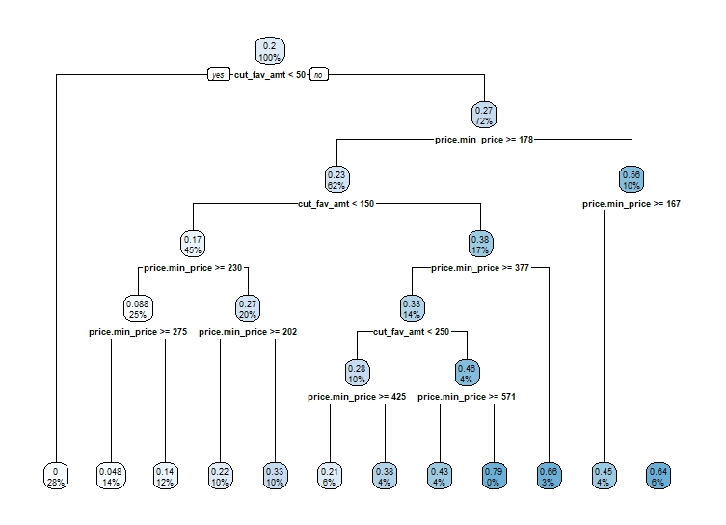
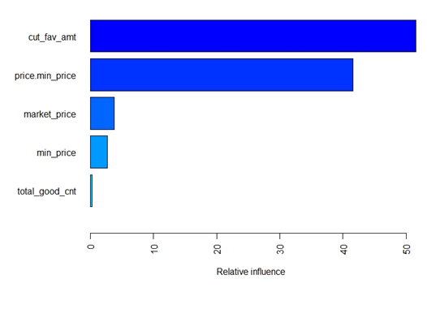
METHODOLOGY
Figure 13 Regression Tree (CART) post parameter tuning
Figure 14. Variable Importance plot for Boosted trees, GBM
Notes:
ID3, CART and C4.5 are the most common decision tree algorithms in data mining which use different pruning strategies and splitting criteria for node splitting at each level. Amongst the different decision tree algorithms, CART (Classification and Regression Trees) is selected due to its ability to handle both categorical and numeric inputs and handle outliers. Additionally, CART can generate regression trees.
The regression tree plot shows that the most important feature is the discount amount followed by the original purchase amount of the customer (before making the additional purchase of the minimum priced good). Based on figure 5, the customer thinks about the discount amount from the full-cut promotion first and then think about what their purchase amount are before deciding if they are interested in the full-cut promotion. For example, customers will observe whether the discount amount is more than ¥50 and then observe whether their original purchase amount is more than ¥178 and ¥167. If the original purchase amount less than ¥167 and the discount amount is more than ¥50, then the customer has an estimated full-cut promotion driven demand of 0.64.
In Boosting, an ensemble of shallow and weak successive trees is added sequentially with each tree learning and improving based on the residuals of the previous models. The construction of successive weak trees is computationally cheap and allows the algorithm to learn slowly; making incremental improvements in the reduction of residuals. This enables the model to avoid overfitting as the learning and construction process can be terminated with a stopping criterion. Additionally, a plot of the importance of input features is created to understand which feature has the largest influence on the output.
Since multiple trees are created, bagged regression trees do not have a single regression tree plot. Instead, the results at each split for all the regression trees are aggregated to determine the variable importance of the features in figure 6. The feature importance is calculated based on the mean decrease impurity, which is defined as the total decrease in node impurity (weighted by the probability of reaching that node (which is approximated by the proportion of samples reaching that node))

Slide 19
CONCLUSION
Proposed Methodology and Future Work.
1
2
3
4
Exploratory Data Analysis
Machine Learning
Proposed Model for Promotion Sensitivity
Customer Segmentation & Comparative study
5
Optimization + Future work
Notes:
In this research paper, we have introduced a methodology to estimate a customer’s demand towards full-cut promotion, segments customers based on this demand
and set up framework to optimize the full-cut promotions. The results in this research is significant for companies as it provides a framework for companies to optimize their full-cut promotions in an E-commerce setting. This framework provides the methods on how to analyze the noisy transactional dataset, the types of machine learning and optimization models to use as well as how to interpret the results.
This methodology begins by Exploratory Data Analysis, identifying the discount and threshold amounts in a noisy transactional dataset. Plotting the histogram for the discount and threshold amounts to understand that customers are more attracted towards which types of full-cut promotion.
Next, we have defined a method to compute the promotion driven demand under certain assumptions
and we trained various machine learning models. From these results, we have identified that decision trees with boosting (GBM) is a preferred model due to its accuracy.
we have also carried out a comparison of discrete choice models to show that traditional models for modelling consumer choices has a lower accuracy than data-driven machine learning models due to the model misspecifications incurred in traditional models.
Next, we have explored various clustering algorithms and segmented the customers into 3 clusters via K-means based on their predicted full-cut promotion
and provide an interpretation for each cluster.
This enables companies to understand the types of customers who respond differently towards the full-cut promotion and understand which customers they should focus on based on their product-level features.
We also implemented conditional gradient as our benchmark model to segment customers and we carry out a comparative study on the choice probabilities of the segmented customers.
We have shown that our proposed approach is viable and similar to the choice probabilities obtained via the conditional approach in Jagabathula’s paper.
Finally, we have shown how the information from our proposed approach and conditional gradient can be used to optimize the full-cut promotions.
by extending the multi-product pricing problem to the context of pricing of threshold and discount amounts in promotion.
In the future work, we can explore the assumptions made during this research and investigate the comparative study of different optimization techniques used in solving the objective function.
It will also be interesting to consider the price sensitivity across products as a non-homogenous factor.
we also assumed that there are no stock-out scenarios. This assumption may be violated, and the sales of the stock-out products will be underestimated and hence, underestimating the full-cut promotion driven demand. Future areas of work may examine the possibility of stock-out products.
Additionally, in section 7, we have assumed that there are no changes in the product assortment across the different time intervals. This is primarily due to limited information in our dataset to capture the choice probabilities across all products at each time interval. In reality, the product assortment changes over time intervals as companies delist old products and include new product offerings. Therefore, a future area of work can involve the consideration of time intervals whereby at each time interval, customers purchase from an offered set of products and offered set across time intervals are different.

Slide 20
REFERENCES
[1] Jagabathula, S., Subramanian, L., & Venkataraman, A. (2018). A Conditional Gradient Approach for Nonparametric Estimation of Mixing Distributions.
[2] Berry, S., Levinsohn, J., & Pakes, A. (1995). Automobile prices in market equilibrium. Econometrica: Journal of the Econometric Society, 841-890.
Notes:
In this section, we seek to use the traditional and popular discrete choice models to model consumer choices between the customer subscribing or not subscribing to the full-cut promotion
And compare the error rates of the traditional model with the regression trees obtained in the previous slides.
Discrete choice models estimate the probability that a person chooses a choice over an assortment of choices and
Binary Logistic Regression is selected since there are only two choices: customers subscribing to full-cut promotion or not subscribing to full-cut promotion.
$𝒴_{i}=1$ defined as customer $i$ subscribing to the promotion, and $𝒴_{i}=0$ defined as customer $i$ who is not subscribing to the promotion.
In the binary logistic regression model, the choice, $𝒴_{i}$ is trained on two features: minimum price of the good in an order ($x_{1}$) and the customer’s original purchase amount discounted with the minimum priced good ($x_{2}$),
$$ln(\frac{y_{i}}{1−y_{i}})=β_{0}+β_{1}x_{1}+β_{2}x_{2}$$
A higher minimum price$x_{1}$ indicates that a customer is willing to pay a higher amount of money to subscribe to the promotion and hence a higher demand to enjoy the full-cut promotion, whereas a lower minimum price indicates a weaker willingness. $x_{2}$ represents the total purchase amount that the customer originally intends to purchase without making additional purchase to enjoy the full-cut promotion. Hence, this investigates the relationship between the customer original purchase amount and whether the customer will subscribe to the promotion.
$β_{0}=−666.6, β_{1} =3.38, β_{2} =3.35$. One-unit increase in the variable $x_{1}$ is associated with the increase in the log odds of being the user subscribing to the promotion vs. not subscribing to the promotion by the value of 3.38. One-unit increase in the variable $x_{2}$ is associated with the increase in the log odds of being the user subscribing to the promotion vs. not subscribing to the promotion by the value of 3.35. The p-value from the 2-tailed Z tests is below the significance level of 0.05, rejecting the null hypothesis, therefore indicating that the Binary Logistic model is significant in explaining the relationship between the features and output.
This misclassification rate for Binary Logit Model is 6.487% and is significantly higher than XGBoost, which is 1.669%. This shows that the XGBoost has a higher accuracy in predicting the customer’s full-cut promotion demand and can fit the data better than a binary logit model which samples from a logistic distribution.

Slide 21
THANK YOU!

Slide 22
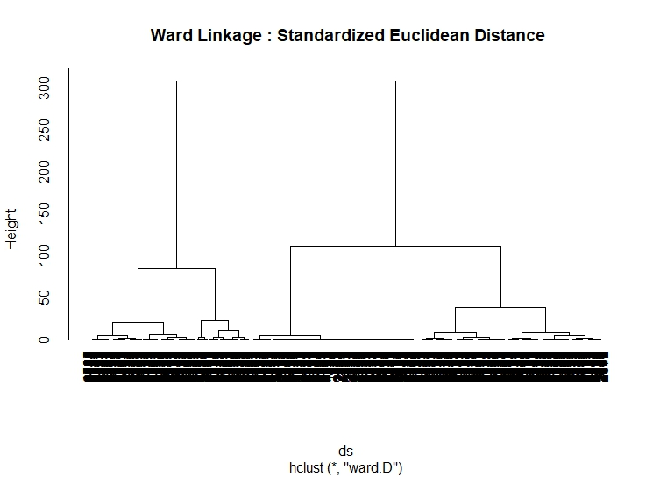
APPENDIX
Example on Hierarchical Clustering.
Figure 13. Dendrogram on Ward’s Linkage
Notes:
The figure shows a dendrograms for Hierarchical Clustering based on Ward’s Linkage.
The optimal number of clusters is the number of branches that passes the red line as shown in the figures below. Therefore, the dendrogram based on Ward’s Linkage shows that the optimal number of clusters is either 3 or 4.
The cutting of the dendrogram to obtain different clusters are based on 2 factors:
based on knowledge of dataset and interpretability of clusters. For example, how easy it is for us to describe the purchasing behaviors of customers.
The second method uses a statistical conventions. The dendrogram can be cut where the difference is most significant.

Slide 23
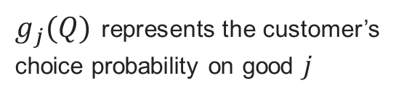
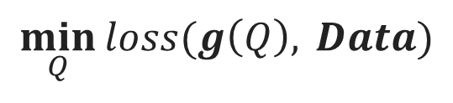
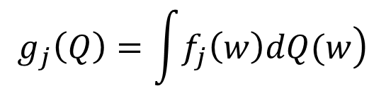


CONDITIONAL GRADIENT SETUP
Goal: Identify customer types and choice probabilities
Estimate the best mixing distribution based on $Data$ from all possible distributions $Q$
By minimizing the Squared Loss function,
$$\min_{Q}{loss(g\left(Q\right), }Data)$$
$$loss\left(g\left(Q\right),Data\right)=\frac{1}{2}\sum_{j∈[n]}{{\left(g_{j}\left(Q\right)−b_{j}\right)}^{2}}$$
$$b_{j}=N_{j}/N$$
$g_{j}(Q)$ represents the customer’s choice probability on good $j$
Assuming that choice probability follows a Multinomial Logit model (MNL),
$$f_{j}\left(w\right)=\frac{exp⁡(w′{∙z}_{j})}{\sum{exp⁡(w′{∙z}_{l})}}$$
$$g_{j}\left(Q\right)=\int{\left.f_{j}\left(w\right)dQ(w\right)}$$
Notes:
In this section, we seek to implement a benchmark model in segmenting and identifying different customer types to our proposed approach.
this benchmark model is a modified conditional gradient approach from Jagabathula’s paper.
This model is unique as it segments customers using product level features instead of using the traditional approach involving customer demographics. This also represents a different approach to what we have proposed and hence, The comparative study for the two approaches. Which involves the comparison of the choice probabilities across each customer type.
To identify the different customer types and the corresponding customer choice probabilities, we need to first identify the distribution of the orders across all goods based on the features.
We used 4 features: market price, discount amounts, count of goods, goods amount.
The goal is to estimate the best fitting mixing distribution based on $Data$ from the space of all possible mixing distributions $Q$, by minimizing the loss function.
The loss function we used is the squared loss function: which measures the square of the mismatch between predicted output from mixing distributions and the proportion of sales in $Data$
To find $g_{j}(Q)$ , the customer’s choice probability, we assumed that the $f_{j}\left(w\right)$ follows the Multinomial Logit model (MNL):
Hence, the customer’s choice probability is a mixture distribution, $Q$,under MNL

Slide 24
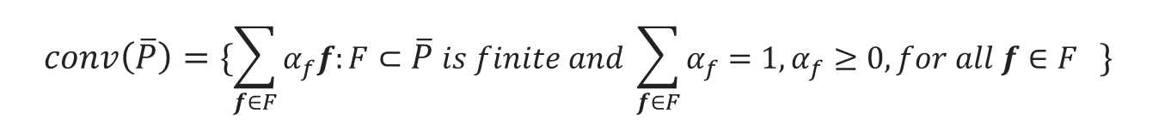



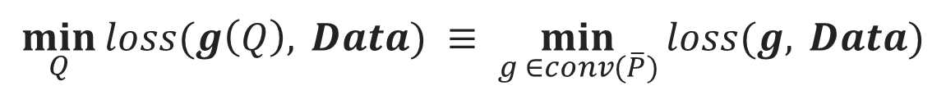
CONDITIONAL GRADIENT SETUP
Instead of optimizing through all possible mixture distributions,
We can simply optimize through the convex hull of choice probability vectors:
$$\min_{Q}{loss(g\left(Q\right), }Data) ≡ \min_{g ∈conv(\overline{P})}{loss(g, }Data)$$
$$where$$
$$conv\left(\overline{P}\right)=\{\sum_{f∈F}{α_{f}f:F⊂\overline{P} is finite and \sum_{f∈F}{α_{f}=1, α_{f}≥0, for all f∈F }}\}{ }$$
$$P=\left\{f\left(w\right): w∈ℝ^{D}\right\}$$
$$f\left(w\right)=\left(f_{j}\left(w\right):j∈\left[n\right]\right)$$
Notes:
In Jagabathula’s paper, they have shown that instead of optimizing through the entire set of all possible mixture distributions,
we can simply optimize through the convex hull of choice probability vectors: $\min_{g ∈conv(\overline{P})}{loss(g, }Data)$
Hence, the objective function (minimization of loss function) only depends on $Q$ through $g\left(Q\right)$.
$conv(\overline{P}$) is the convex hull of the closure of the set of all choice probabilities across all goods and weights $w.$Intuitively $conv(\overline{P}$) represents the space of all customer choice probabilities, and $g$ is an element in this space.
Convex hull refers to the smallest convex set that contains $\overline{P}$. This means that for any 2 points x, y in $\overline{P},$ the line that joins x and y will still be within $\overline{P}$. This is important because any convex combination of choice probabilities, the resulting convex sum must still be a valid choice probability.
From Jagabathula’s paper, it is also shown that this set of mixture likelihood vectors, $P$, is convex and is analogous to $f\left(w\right)=(f_{j}\left(w\right):j∈\left[n\right])$.
closure of a set $P$ is the set that consists of all points in $P$ together with all limit points of $P$.
A limit point x in $P$ is a point whereby every neighbourhood of x contains at least one point of $P$ different from x itself.

Slide 25
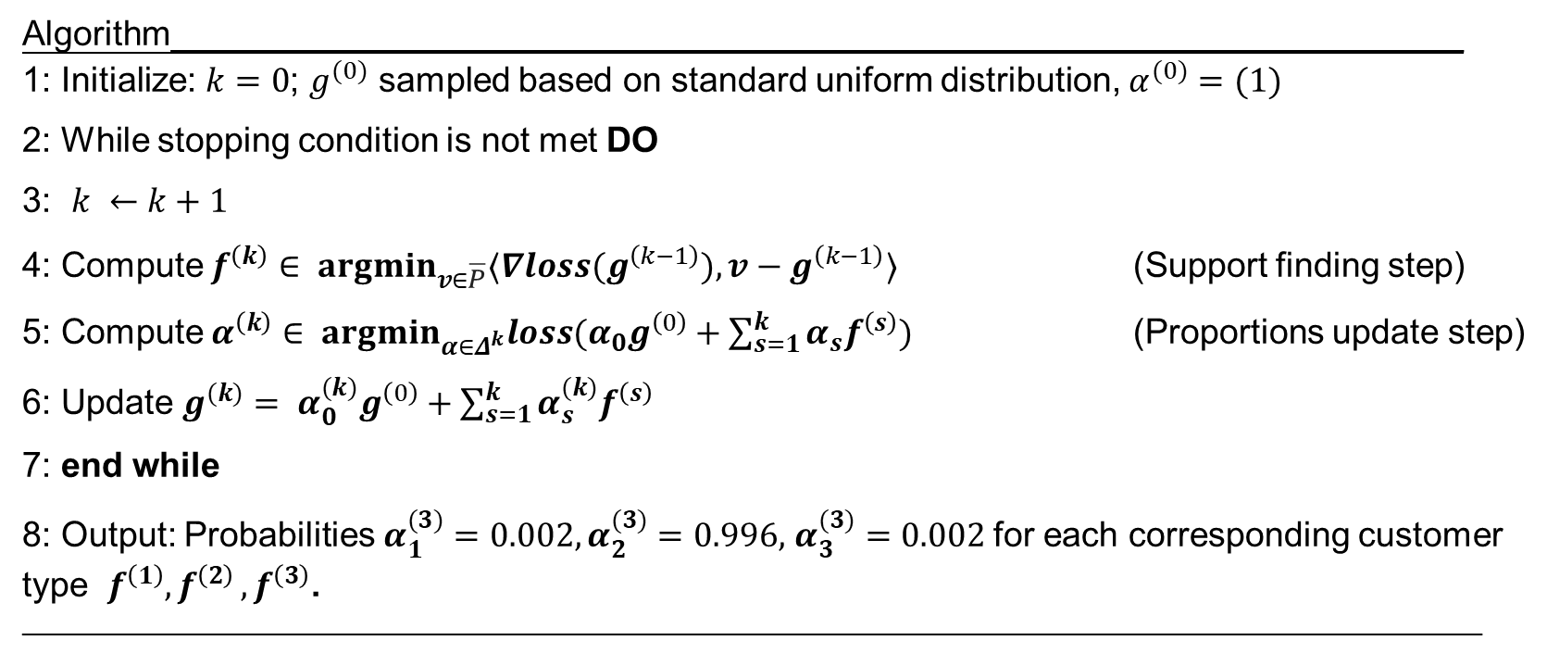

CONDITIONAL GRADIENT ALGORITHM
Algorithm___________________________________________________________________ 1: Initialize: $k=0$; $g^{(0)}$ sampled based on standard uniform distribution, $α^{(0)}=(1)$
2: While stopping condition is not met DO
3: $k ←k+1$
4: Compute $f^{\left(k\right)}∈ {argmin}_{v∈\overline{P}}⟨∇loss(g^{\left(k−1\right)}), v−g^{\left(k−1\right)}⟩$ (Support finding step)
5: Compute $α^{\left(k\right)}∈ {argmin}_{α∈Δ^{k}}loss(α_{0}g^{\left(0\right)}+\sum_{s=1}^{k}{α_{s}f^{\left(s\right)}})$ (Proportions update step)
6: Update $g^{(k)}= α_{0}^{(k)}g^{\left(0\right)}+\sum_{s=1}^{k}{α_{s}^{(k)}f^{\left(s\right)}}$
7: end while
8: Output: Probabilities $α_{1}^{(3)}=0.002, α_{2}^{(3)}=0.996,$ $α_{3}^{(3)}=0.002$ for each corresponding customer type $f^{\left(1\right)}{,f}^{\left(2\right)},f^{\left(3\right)}$. __________________________________________________________________________________________________________________
$f^{\left(k\right)}$ is a choice probability vector across all 95 types of products
$α^{(k)}$ is the likelihood that a customer′ s choice probability follows $f^{\left(k\right)}$
$$g=α_{1}^{(3)}∗f^{\left(1\right)}+α_{2}^{(3)}∗{ f}^{\left(2\right)}+{ α}_{3}^{(3)}∗f^{\left(3\right)}$$
is the average customer’s choice probability
Notes:
The steps in the conditional gradient algorithm is as shown in Algorithm below.
We begin by using an initial choice probability, denoted as $g^{(0)}$, which is obtained from simulating a uniform distribution of values from 0 to 1 where the sum of the choice probabilities in each transaction is equals to 1.
We also initialize the number of iterations, $k=0$, and $α^{(0)}$ as a unit vector.
$α^{0}$ denotes the corresponding likelihood for each of the customer’s choice probability $g^{(0)}$.
For each iteration $k,$we seek to obtain the customer choice probability, $f^{(k)}$in the support finding step, the corresponding likelihood $α^{(k)}$ in the proportions update step, and update the $g^{(k)}$ as inputs for the support finding step in the next iteration.
At each iteration of the support finding step, the conditional gradient algorithm obtains an optimal descent direction by minimizing the product of the gradient to the Squared Loss function to the difference of choice probabilities, over the space of choice probabilities denoted as $\overline{P}$. $f^{\left(k\right)}$is taken as the choice probability of new customer type $k$
In the proportions update step, the likelihood of the customer type $k$ is denoted as $α^{(k)}$ and is calculated by finding the choice probabilities in a simplex that minimizes the Squared Loss function of the weighted sum of all the customer types identified. Essentially, this can be interpreted as searching for the likelihood vector of $α^{(k)}$ that minimizes the error function.
The input for the next iteration in our optimization of descent direction (step 4, support finding step) is updated with the new $α^{(k)}$and $g^{k}$ by simply re-weighing $g^{k}$ with the new convex sum of choice probabilities and likelihood. The final solution at each iteration $k$is based on the convex sum of both the customer type k and the previous solution $g^{k−1}$.
The results show that the mixing distribution is made up of 3 different customer types $g^{1}, { g}^{2}, g^{3}$. Which are choice probabilities across all 95 goods and the corresponding likelihoods which are: $α^{1}=0.002, α^{2}=0.996$ and $α^{3}=0.002.$

Slide 26

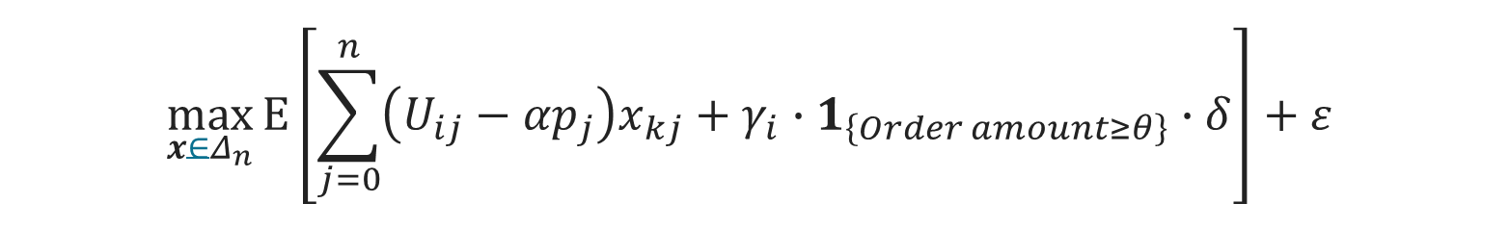



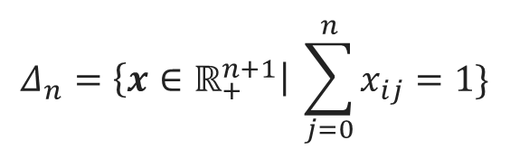

OPTIMIZATION
Goal: Obtain threshold & discount amount that maximizes revenue
By identifying the choice probability for each type of promotion,
Assuming customers seek to maximize utility in their purchases,
$$\max_{x∈Δ_{n}}{Ε\left[\sum_{j=0}^{n}{\left(U_{ij}−{αp}_{j}\right)x_{kj}+γ_{i}∙1_{\left\{Order amount≥θ\right\}}∙δ}\right]+ε}$$
$$where$$
$$Δ_{n}=\left\{x∈ℝ_{+}^{n+1}\right| \sum_{j=0}^{n}{x_{ij}=1}\}$$
constraint space for choice probabilities across goods
$j ∈product universe [n]$ and $j=0$ denotes the outside option
$$x_{kj}$$
denotes the choice probability,
$$p_{j}$$
denotes the price of good
$$j$$
$$α$$
denotes price sensitivity
Notes:
After identifying the promotion-driven demand, the customer types and their choice probabilities,
In this section, we will use all of these information to set up the framework for optimization of full-cut promotions.
Our goal is to identify the threshold and discount amount that will maximize the total revenue across all products.
This is done by identifying the customer’s choice probability across all products for each threshold-discount amount permutation,
Hence we need to model the customer’s utility of purchasing across all products in conjunction with the full-cut promotion,
This objective function of the customer’s utility is shown as above. This objective function is adapted from a representative consumer model in Yan’s paper.
I will explain each term in this objective function.
Triangle with a subscript n represents the constraint space for choice probabilities, where the sum of individual probabilities for each product must be 1.
$j$ represents the product ID and $i$ represents the customer. $j$ = 0 is the outside option which means the option of customer not purchasing product $j$.
$x_{ij}$ represents choice probability of customer $i$ buying product $j$.
$p_{j}$ represents the price of product $j$
$α$ represents the price sensitivity for each price. This can be homogenous or non-homogenous.

Slide 27




OPTIMIZATION
Goal: Obtain threshold & discount amount that maximizes revenue
By identifying the choice probability for each type of promotion,
Assuming customers seek to maximize utility in their purchases,
$$\max_{x∈Δ_{n}}{Ε\left[\sum_{j=0}^{n}{\left(U_{ij}−{αp}_{j}\right)x_{kj}+γ_{i}∙1_{\left\{Order amount≥θ\right\}}∙δ}\right]+ε}$$
$$where$$
$$γ_{i}∙1_{\{Order amount≥θ\}}∙δ$$
positive utility from full-cut promotion
$γ_{i}$ denotes the customer $i$’s sensitivity parameter to full-cut promotion
$δ$ denotes the discount amount
$θ$ denotes the threshold amount
Notes:
This objective function of the customer’s utility is shown as above. I will explain each term in this objective function.
$θ$ denotes the threshold amount
$δ$ denotes the discount amount
$γ_{i}$ denotes the customer’s sensitivity to the full-cut promotion
$γ_{i}∙1_{\{Order amount≥θ\}}∙δ$ is a function representing the full-cut promotion. When order amount is more than threshold and no. of products >= 2,
then the output is discount weighted with the sensitivity
$γ_{i}∙1_{\{Order amount≥θ\}}∙δ$ denotes the positive utility or reward to the customer $i$ as a result of the full-cut promotion discount

Slide 28





OPTIMIZATION
Goal: Obtain threshold & discount amount that maximizes revenue
By identifying the choice probability for each type of promotion,
Assuming customers seek to maximize utility in their purchases,
$$\max_{x∈Δ_{n}}{Ε\left[\sum_{j=0}^{n}{\left(U_{ij}−{αp}_{j}\right)x_{kj}+γ_{i}∙1_{\left\{Order amount≥θ\right\}}∙δ}\right]+ε}$$
$$where$$
$$U_{ij}=w_{k}^{′}∗z_{ij}$$
denotes the customer’s utility for good
$$j$$
$$w_{k}^{′}$$
denotes the customer’s preferences
$$z_{ij}$$
denotes the good’s features
Notes:
This objective function of the customer’s utility is shown as above. I will explain each term in this objective function.
$z_{ij}$ denotes the good’s features for customer $i$: market price, discount amounts, count of goods, goods amount.
$w_{k}^{′}$ denotes the customer’s preferences for each of the features. We assumed that customer $i$ belongs to customer type $k$
We will discuss how to obtain the $w_{k}$ preference vector in the next slide.
$U_{ij}$ denotes the customer $i$’s valuation for product $j$. We evaluate $U_{ij}=w_{k}^{′}∗z_{ij}$,
$U_{ij}− αp_{j}$ represents customer $i$’s utility on product $j$ after subtracting with its price.

Slide 29





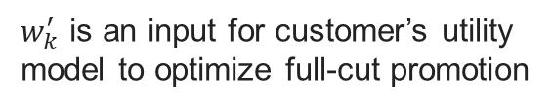

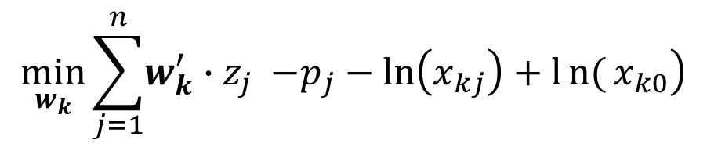
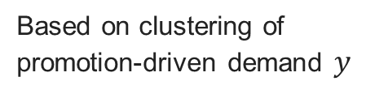
OPTIMIZATION
Goal: Obtain threshold & discount amount that maximizes revenue.
$w_{k}^{′}$ is an input for customer’s utility model to optimize full-cut promotion
To obtain the preference vector $w_{k}^{′}$ for each customer type $k$,
Minimize the error between customer’s utility and choice probability,
$$\min_{w_{k}}{\sum_{j=1}^{n}{\left.w_{k}^{′}{∙z}_{j} −p_{j}−\ln\left(x_{kj}\right)+ln{(}x_{k0}\right)}}$$
Constant
Based on clustering of promotion-driven demand $y$
$$where$$
$$x_{kj}$$
denotes the choice probability of customer type $k,$ product $j$
$$x_{k0}$$
denotes the choice probability of customer type $k,$ not buying product $j$
$$w_{k}^{′}$$
denotes the customer type $k$ preferences
$$z_{j}$$
denotes the good $j$ features
Notes:
To obtain the preference vector $w_{k}^{′}$ for each customer type $k$,
We make use of the idea that the price, $p_{j}$is a function of choice probabilities,
$$\left.{p_{j}= w}^{\left(k)′\right.}{∙z}_{j} −\ln\left(x_{kj}\right)+ln{(}x_{k0}\right)$$
This is again adapted from Yan’s paper. Hence, for all observations belonging to each customer type $k$
we are trying to find the optimal weight $w^{\left(k\right)}$ that minimizes the error based on the price function
$x_{kj}$denotes the choice probability of customer type $k,$ product $j$
$x_{k0}$denotes the choice probability of customer type $k,$ not buying product $j$
$z_{j}$ denotes the good $j$ features
We can set the constraint space for each element in the preference vector to be from 0 to 1 real value.

Slide 30



OPTIMIZATION
Optimization to obtain threshold & discount amount.
Goal: To identify threshold & discount amount that maximizes total revenue across all products
For each ($θ$,$δ$), we obtain the $x$
With the profit margin vector of all goods, $p,$
$$\max_{(θ,δ)∈(θ,δ)}{x∗p}$$
($θ^{∗}$, $δ^{∗}$) with a highest revenue, ${\left(x∙p\right)}^{∗}$ will be the optimal threshold and discount amount
Notes:
First, we set constraints and space for the threshold and discount amounts, $θ$ and $δ$.
Hence, for each type of full-cut promotion, defined by the pair of threshold and discount amount ($θ$, $δ$), we obtain customer $i$ choice probability $x_{i}$
We repeat this for all the customers and obtain the mean for the choice probabilities, denoted as $x$
To identify the type of full-cut promotion that leads to the highest revenue, we simply take the product of $x$ with the vector of profit margin for each product, denoted as $p$. Hence, we obtain the optimal full-cut promotion ($θ^{∗}$, $δ^{∗}$) with a highest corresponding value, ${\left(x∙p\right)}^{∗}.$
This enables E-commerce companies to identify which type of full-cut promotion will lead to the highest revenue based simply on the product-level features of the customers in the transactional dataset.

Slide 31
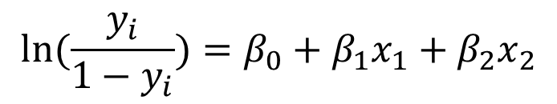
Comparative study with Discrete Choice models
$$ln(\frac{y_{i}}{1−y_{i}})=β_{0}+β_{1}x_{1}+β_{2}x_{2}$$
$$β_{0}=−666.6 β_{1} =3.38, β_{2} =3.35$$
$x_{1}:$ minimum price of the good in an order $x_{2}:$ order amount discounted with the minimum priced good
 | Misclassification rate
Binary Logit Model | 6.487 %
XGBoost | 1.669%
Notes:
In this section, we seek to use the traditional and popular discrete choice models to model consumer choices between the customer subscribing or not subscribing to the full-cut promotion
And compare the error rates of the traditional model with the regression trees obtained in the previous slides.
Discrete choice models estimate the probability that a person chooses a choice over an assortment of choices and
Binary Logistic Regression is selected since there are only two choices: customers subscribing to full-cut promotion or not subscribing to full-cut promotion.
$𝒴_{i}=1$ defined as customer $i$ subscribing to the promotion, and $𝒴_{i}=0$ defined as customer $i$ who is not subscribing to the promotion.
In the binary logistic regression model, the choice, $𝒴_{i}$ is trained on two features: minimum price of the good in an order ($x_{1}$) and the customer’s original purchase amount discounted with the minimum priced good ($x_{2}$),
$$ln(\frac{y_{i}}{1−y_{i}})=β_{0}+β_{1}x_{1}+β_{2}x_{2}$$
A higher minimum price$x_{1}$ indicates that a customer is willing to pay a higher amount of money to subscribe to the promotion and hence a higher demand to enjoy the full-cut promotion, whereas a lower minimum price indicates a weaker willingness. $x_{2}$ represents the total purchase amount that the customer originally intends to purchase without making additional purchase to enjoy the full-cut promotion. Hence, this investigates the relationship between the customer original purchase amount and whether the customer will subscribe to the promotion.
$β_{0}=−666.6, β_{1} =3.38, β_{2} =3.35$. One-unit increase in the variable $x_{1}$ is associated with the increase in the log odds of being the user subscribing to the promotion vs. not subscribing to the promotion by the value of 3.38. One-unit increase in the variable $x_{2}$ is associated with the increase in the log odds of being the user subscribing to the promotion vs. not subscribing to the promotion by the value of 3.35. The p-value from the 2-tailed Z tests is below the significance level of 0.05, rejecting the null hypothesis, therefore indicating that the Binary Logistic model is significant in explaining the relationship between the features and output.
This misclassification rate for Binary Logit Model is 6.487% and is significantly higher than XGBoost, which is 1.669%. This shows that the XGBoost has a higher accuracy in predicting the customer’s full-cut promotion demand and can fit the data better than a binary logit model which samples from a logistic distribution.

